Slide 1
Health Risks of Obesity
FNU 103

Slide 2
Obesity Facts
Overweight and obesity are defined as abnormal or excessive fat accumulation that may impair health
Worldwide obesity has nearly tripled since 1975.
Most of the world's population live in countries where overweight and obesity kills more people than underweight.
41 million children under the age of 5 were overweight or obese in 2016.
Over 340 million children and adolescents aged 5-19 were overweight or obese in 2016.
Obesity is preventable.

Slide 3
Overweight vs Obese
OVERWEIGHT | OBESE
Excess amount of body weight from: Fat, muscle, bone, water | Excess amount of body fat
Athletes with large muscle mass typically fall in the overweight category but have very little body fat. | You can be thin and have a high percentage of body fat.

Slide 4
Adult Obesity Prevalence in 2016- Reports from the CDC (Center for Disease Control and Prevention)
As education level increased, obesity decreased. Adults without a high school degree or equivalent had the highest self-reported obesity (35.5%), followed by high school graduates (32.3%), adults with some college (31.0%) and college graduates (22.2%).
Young adults were half as likely to have obesity as middle-aged adults. Adults aged 18-24 had the lowest self-reported obesity (17.3%) compared to adults aged 45-54 years who had the highest prevalence (35.1%).
CDC provided the following map to show the prevalence of self-reported obesity among adults in the United States in 2016.

Slide 5
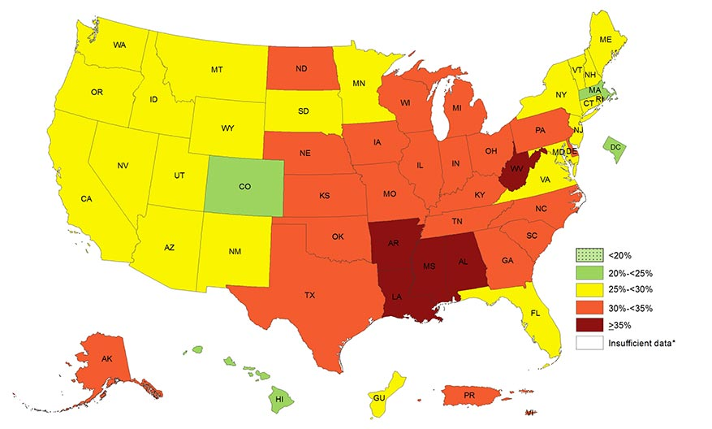

Slide 6
What Causes Obesity and Overweight?
Energy imbalance between calories consumed and calories expended
An increase in intake of high-fat foods
An decrease in physical activity
Primarily, you inherit your body type.
Smoking and excessive alcohol increase fat in stomach area for men and women.
Notes:
Instead of “Obesity runs in my family” it should be “My family is obese because they don’t run”.

Slide 7
Changes in Diet and Exercise
Changes in dietary and physical activity patterns are often due to the lack of supportive sectors in:
Health
Agriculture
Transportation
Environment
Food processing
Marketing
Education

Slide 8
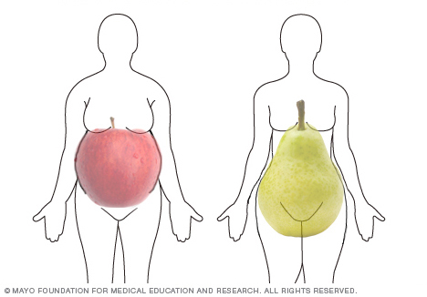
Apple shape vs. Pear Shape
Android (Apple Shaped)
Building up fat in the stomach area, developing a “Pot Belly,” or “Beer Belly”
More apt to develop diabetes, heart disease, and other complications of metabolic syndrome.
Metabolic syndrome: a cluster of conditions: increased blood pressure, high blood sugar, excess body fat around the waist, and abnormal cholesterol or triglyceride levels — that occur together, increasing your risk of heart disease, stroke and diabetes.
Gynoid (Pear Shaped)
Collecting around the hips, buttocks, and thighs, developing “Saddle bags”

Slide 9
Heart Disease & Obesity
Heart disease: #1 killer for men & women in U.S.
70% diagnosed cases are related to obesity.
Weight gain of 20 lbs. doubles your risk of heart disease.
http://www.heart.org/HEARTORG/Conditions/HeartAttack/HeartAttackToolsResources/Heart-Attack-Risk-Assessment_UCM_303944_Article.jsp
https://www.heart.org/gglRisk/main_en_US.html
http://mylifecheck.heart.org/Default.aspx?NavID=1&CultureCode=en-US
http://www.nbcnews.com/health/heart-health/these-10-foods-affect-your-risk-heart-disease-most-n730141

Slide 10
Cancer & Obesity
American Institute of Cancer research says:
Being a healthy weight is the MOST important thing you can do to prevent cancer.
Overweight and Obesity increase risk of 11 different types of cancer.
AICR estimates that excess body fat is the cause of 132,800 U.S. cancer cases every year.
http://www.aicr.org/learn-more-about-cancer/infographics/infographic-obesity-and-cancer.html

Slide 11
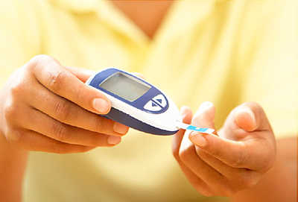
Diabetes & Obesity
80% of people with type 2 diabetes are obese
Losing 10lbs can reduce your risk by 30%
Diabetics that lose 5% body weight decrease blood glucose levels

Slide 12
Gallbladder Disease, High blood pressure, respiratory problems & Obesity
Women who are 40% over IBW have a 33% greater chance of having gallstones.
70% of obese American men and women have HTN
Losing 5-10 pounds can produce significant benefits
Respiratory problems: Losing 10-15% of body weight can in some individuals cure sleep apnea.

Slide 13

Obesity & other Health Hazards
Asthma
Bladder control problems
Depression
Increases risk of complications during surgery
Menstrual irregularities
Pregnancy complications
Premature death
Stroke

Slide 14
What is a Healthy Weight?
A healthy weight is a range that relates statistically to good health.
A healthy weight depends on more than the number on the scale.
A healthy weight allows you to do the activities you enjoy.

Slide 15
Assignment #1a
What are your personal weight and/or exercise goals for this quarter? Place page in your folder to be turned the last day of our class.

Slide 16

Assignment #1b
Download the Kahoot! App
Create an account on Kahoot! and be prepared to login during class throughout the quarter.

